Slide 1
ClimateWins
Final Report
Samantha Guerrier
8/31

Slide 2
The Objective
By using a mixture of machine learning and data analysis, the goal of this project is to identify and predict events resulting from climate change by using data from national and government agencies.
Climate change is happening, the next step is predicting what that looks like
Notes:
Ideally, predicting these events will keep communities safe from experiencing the extreme effects of climate change.

Slide 3
The Three Thoughts
Pleasant Countries
Theory | Southern Hemisphere Countries will experience extreme temperature events
Current | Currently, this thought is generally true due to the location of southern countries & states
Question | Will southern regions be habitable as climate change continues?
Disasters
Theory | Historical data can predict hurricanes and tornadoes
Current | Meteorologist use satellites, drones and weather models to predict these events.
Question | Can a learning model predict these events sooner than the current method?
Temp. Extremes
Theory | Historical data can predict blizzards or heat waves.
Current | Meteorologist use historical data, weather models and satellites to do this.
Question | Can a learning model use the same tools as a human accurately?

Slide 4
Machine Learning Options
Optimized Marketing | Anomaly Detection | KNNs | Temporal Difference Learning | GANS | Integrated Forecasting System | Random Forests
Not Applied | Theorized | Applied | Theorized | Applied | Applied | Applied
Could be used to improve citizen reactions when recommended to evacuate | Used to predict patterns concerning temp, wind speed and pressure | Used to predict weather with historical data or to generate synthetic data | Could be used to predict upcoming weather when given an hourly, or daily input | Used in weather forecasts & current climate change research | Used for operational forecasts. Makes predictions using recent data | Used to post-process precipitation and predict rainfall
Notes:
Refer to phone note to give brief summary of each model

Slide 5
The Data We Need
Humidity
0.05
Wildfires
Hurricanes
Pressure
0.01
Weekly
0
Blizzards
Accuracy
Tsunamis
Efficiency

Slide 6
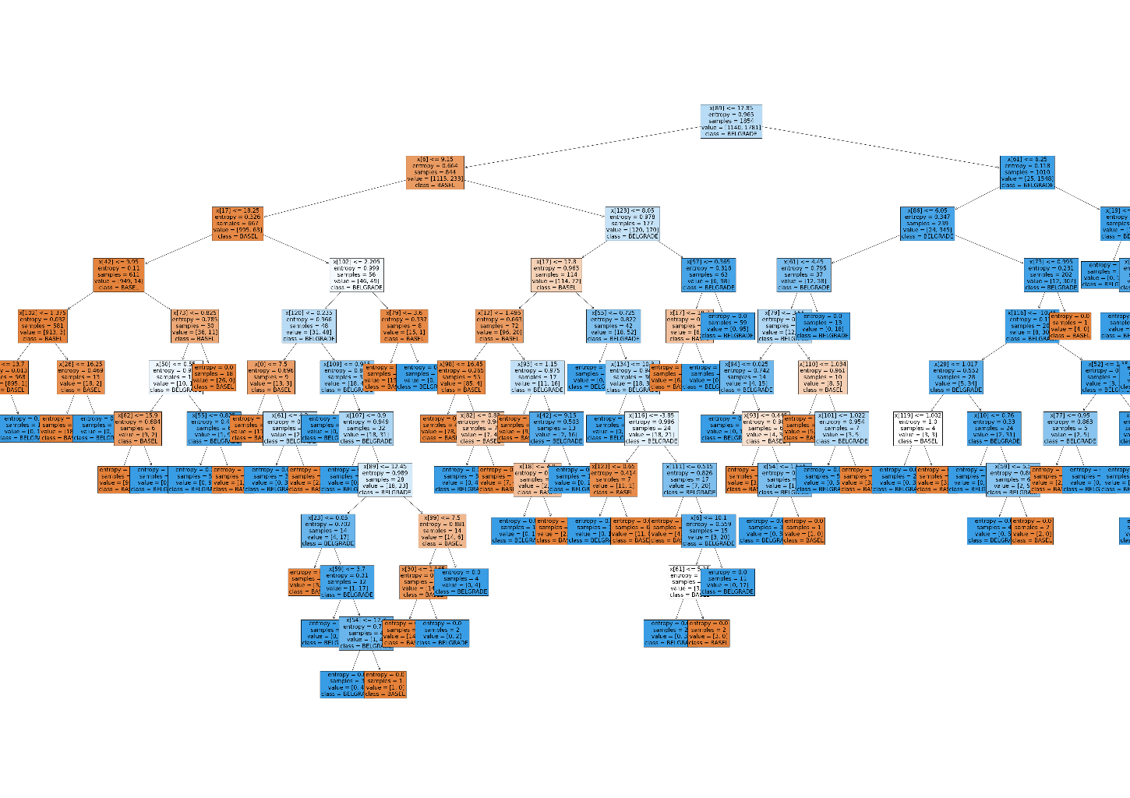
Pleasant Countries
An example of a optimized decision tree
The data needed to identify pleasant countries other than our historical dataset would be daily temperature data and humidity data to predict the effects of climate change in regions that already experience higher temperatures.
A decision tree could be good for making these predictions as the only factors we would be looking at is location and temperature.

Slide 7
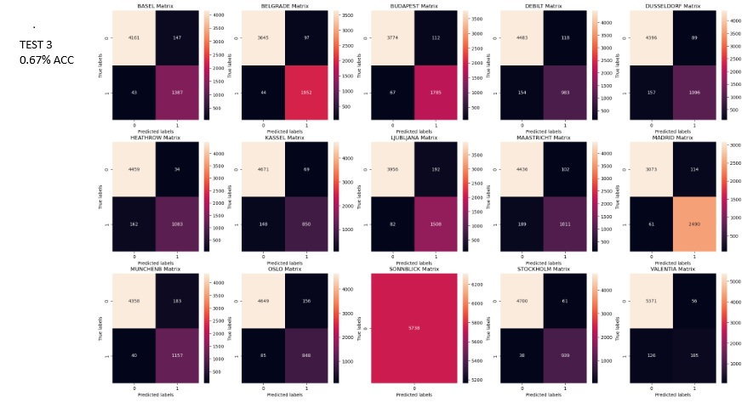
Extreme Temperature
Example of ANN results
The data needed to identify pleasant countries other than our historical dataset would be daily temperature data, pressure data and moisture as pressure can be indicative of heat waves and moisture indicative of blizzards.
A ANN Model would do well combining several factors to predict extreme weather events such as blizzards or heat waves.

Slide 8
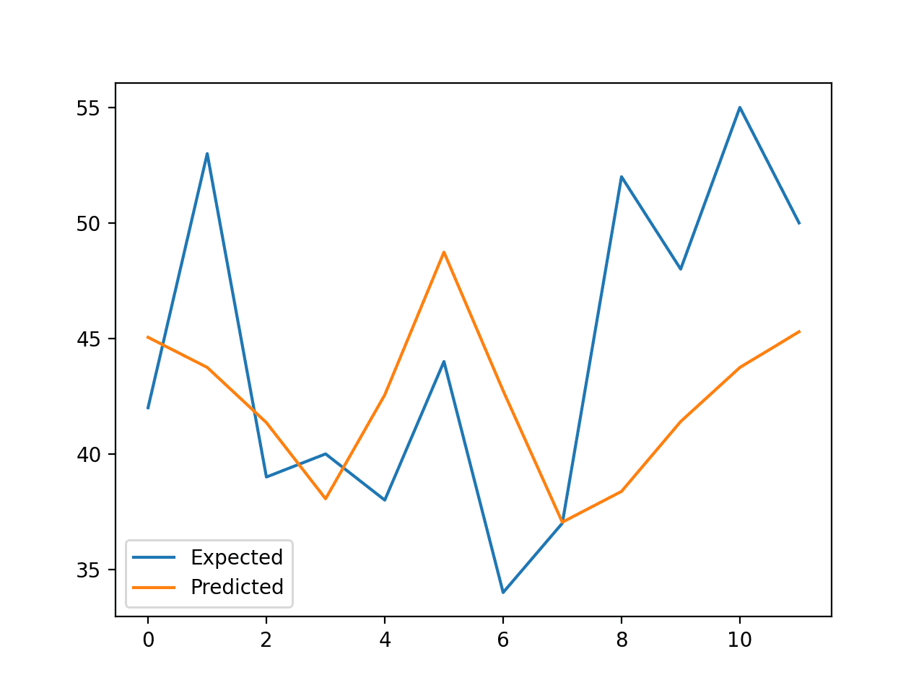
Disaster Prediction
An example of a RF in weather (not my image)
The thought is a model will be able to identify regions that are more likely to experience hurricanes, tornadoes and tsunamis and use machine learning to predict these disasters before they occur. The additional data needed would be precipitation, pressure, and humidity.
The optimized random forest method would be ideal as regional subsets of the data can be made and the model can make predictions off of that.

Slide 9
Recommendations and Summary
The thought experiment that we should move forward with is Pleasant Weather.
We would need consistent
Temperature data
Humidity data
In order to predict which sunshine regions are more at risk to be affected by climate change.
Machine learning models such as optimized decision trees and CNN models would be best to do so.
Results
Higher Weather Prediction Accuracy
The CNN model currently predicts with an accuracy range of 95-98% (it fluctuates each time the model is ran).
Improved Categorization
The decision tree can categorize data with more efficiency when optimal parameters are found, this can be useful to differentiate the regions that are likely to experience the high temperature effects of climate change

Slide 10
Weather Forecast Infographics
Mercury
Saturn
24°
21°
Thank you for your time!
Sunny
Partly cloudy
Any Questions?
Venus
19°
Reach out at
guerrieranalytics@gmail.com
Stormy

